Slide 1
UAV market in Poland
application, producers, requirements
Aneta Kuś
Centrum Naukowo-Technologiczne Systemów Bezzałogowych

Slide 2
Aneta Kuś
President of the Management Board in Science-Technology Centre for Unmanned Systems,
UAVO’s training courses Coordinator,
Unmanned Aircraft Systems Cluster’s Coordinator,
Assistant lecturer in IT Department of Rzeszow University of Technology

Slide 3
Drone market in Poland - numbers
approx. 250 mln PLN – value of drones services market in Poland,
approx. 8 thous. – number of drone pilot’s certificates that were legitimated by september this year,
approx. 400 thous. – estimated number of professional unmanned vehicles, which will be use for doing different tasks in air space of European Union about 2025 year every day.
Źródła:
serwis money.pl, PFR: Usługi dronowe stają się polską specjalnością
serwis informacyjny PAP, Polskie drony lądują w Ameryce Północnej

Slide 4
Polish producers in drone industry
25 producers – building of unmanned vehicles,
over 80 eneterprises – creating technology, equipment, control systems, data transmissions and software that is used in different types of unmanned vehicles.
Źródło:
portal defence24.pl, Dynamiczny rozwój rynku dronów w Polsce. Bezzałogowce są częścią „Internetu Rzeczy”

Slide 5
Drone utilisation – main domains
film production and photography,
precision agriculture,
public safety,
spatial economy,
geodesy,
energy production,
mining,
transportation and shipping.

Slide 6
Precision agriculture
precise and noninvasive examination of cultivation,
creating three-dimensional maps of cultivation,
aerial spraying,
deterrence of wild animals, which destroy cultivation,
preparing detail photo documentation in applying for reparation process, caused by loses endured,
controlling a work of people emplyed in a farm.

Slide 7
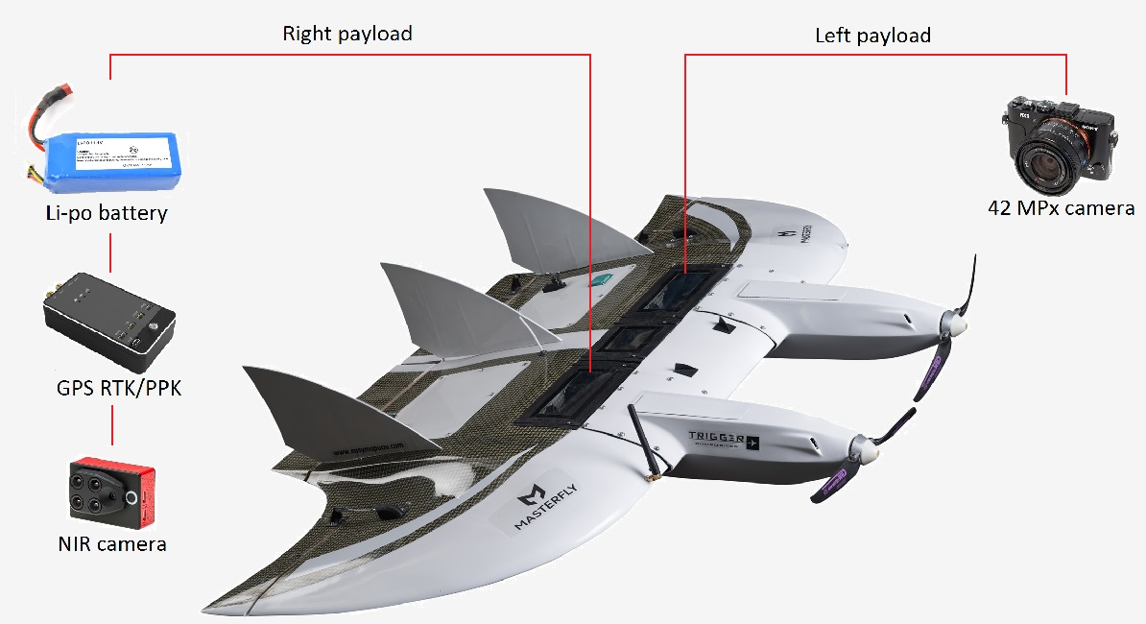
Trigger Composites
MasterFly UAV – airframe for demanding photogrammetry missions and recognition missions.

Slide 8
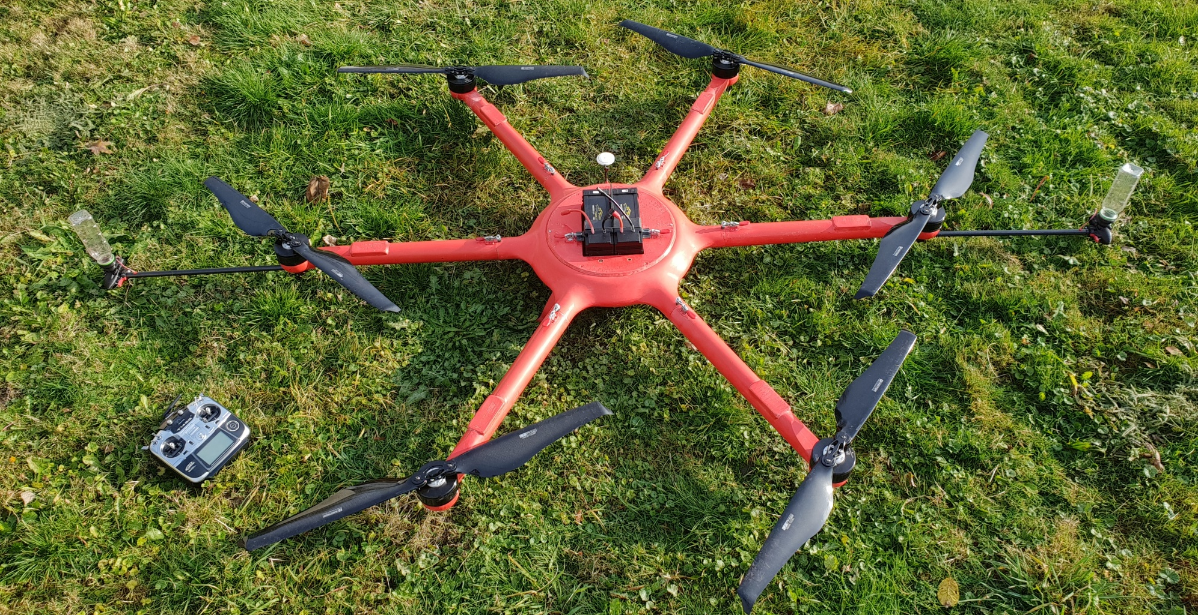
Fotoacc - Agrodron
Agrodron – multirotor prepared for biological spraying.

Slide 9
Uniformed services
missing persons search-and-rescue missions,
observation and mensuration an intensity of traffic,
identification and neutralisation of explosive payloads,
observation and tracking suspects,
observation hard-to-reach areas or places exposed for increased criminal activity,
monitoring large assemblages and protests, when air supervision is essential for risk assessment,
supporting border guards in cotrol and security bordes area,
trapping suspect unmanned vehicles.

Slide 10
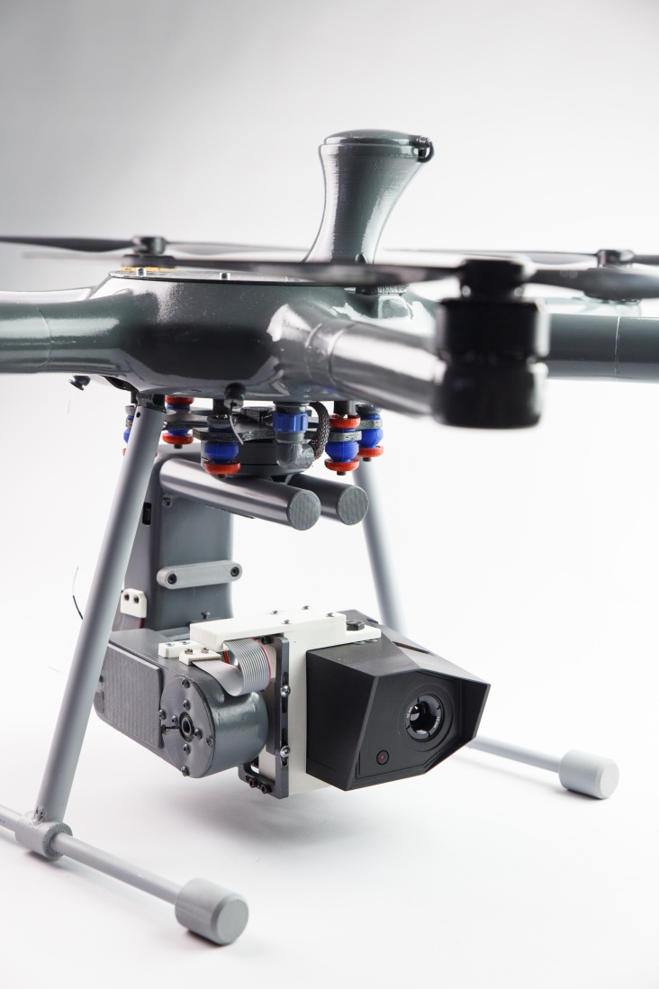
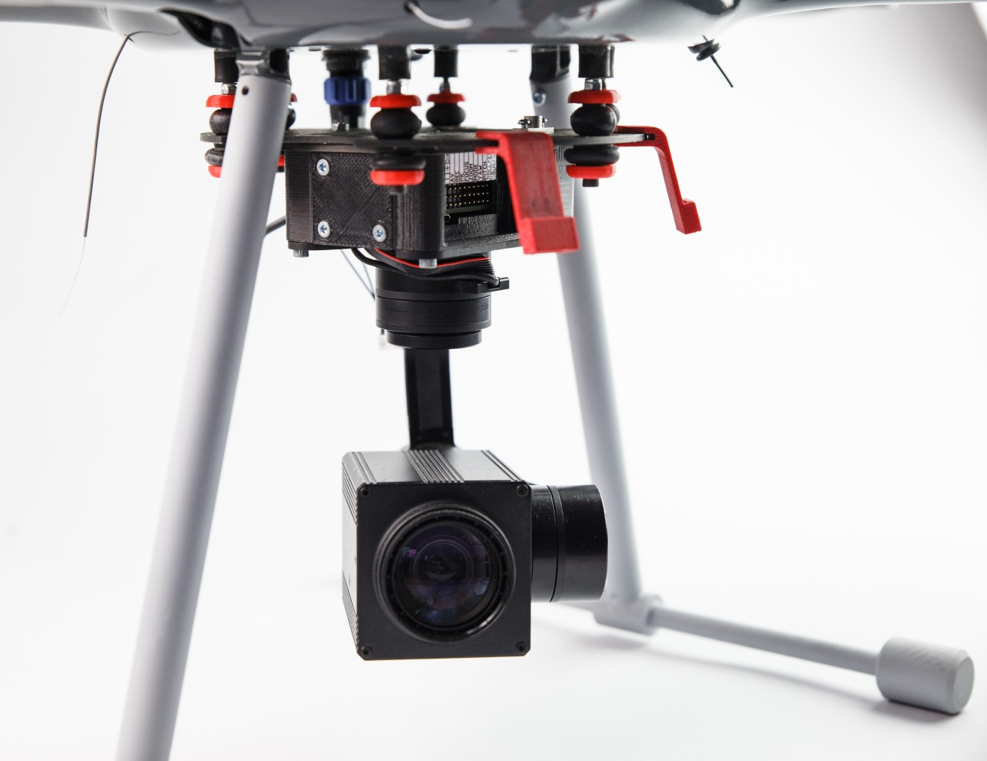
Fotoacc – X-01
Heksakopter X-01 – multirotor with thermal imaging camera or high zoom camera that is used for obserwation and search-and-rescue missions.

Slide 11
Transportation and shipping
delivering packages,
military transportation to fields of war,
providing vaccines, medicine and blood to medical facilities located in distatnt and hard-to-reach areas,
providing blood in fast transfusion necessity coincidences,
smuggling.

Slide 12
Cervi Robotics
AirVein – drone transportation of blood products project.
Dronhub – drone hangar designed to recharge drones.

Slide 13
Drone market’s requirements
abiding a rule of technological neutrality in public orders,
allowing operators with authorization to perform beyond visual line of sight drone flights (BVLOS) without necessity of making airspace reservation so much earlier,
safety integration of unmanned vehicles flights with manned aircraft,
creating a drone traffic management system, in other words integrating drone’s traffic and providing an ICT suport in order to assure safe flights,
providing possibilities and infrastructure for safe testing unmanned and autonomous aircraft systems,
creating a long-term, stabilized funding of research and development projects.

Slide 14
Thank you for your attention
Aneta Kuś
Centrum Naukowo-Technologiczne Systemów Bezzałogowych

